Slide 1
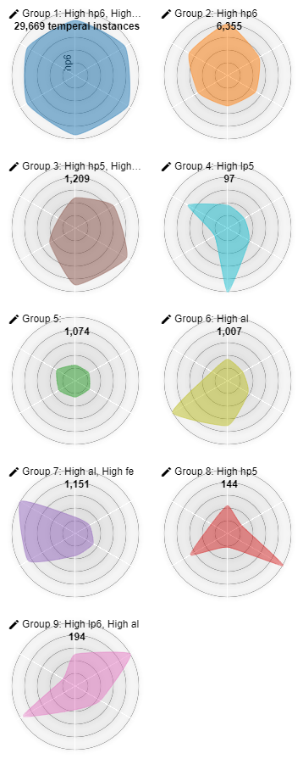
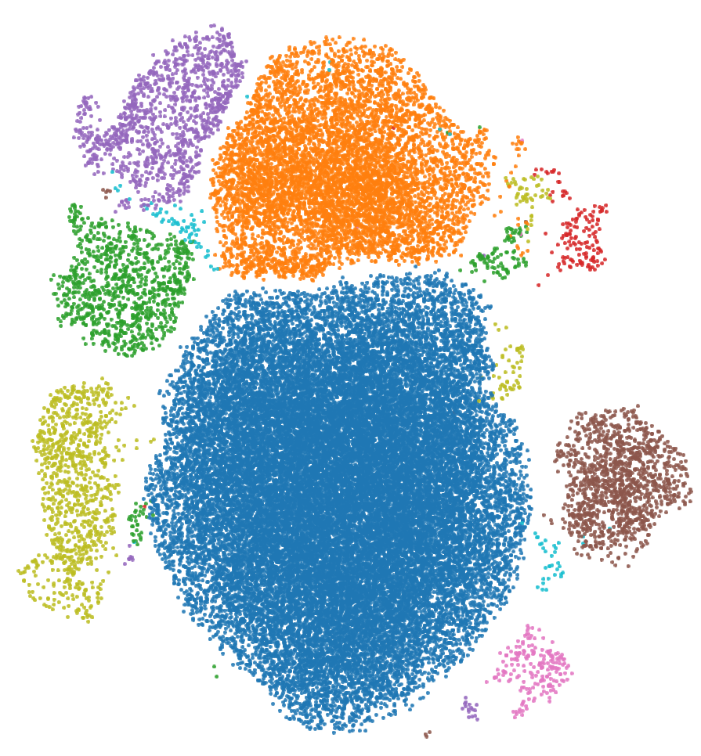

Slide 2
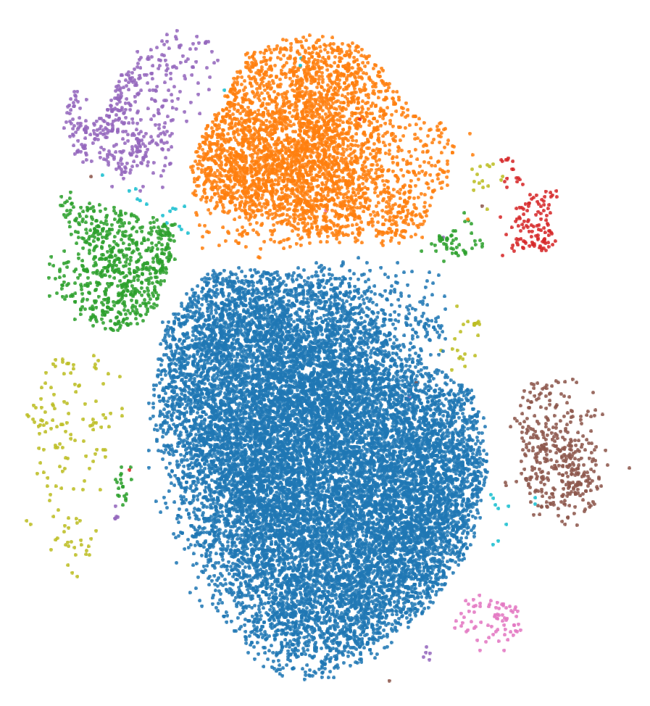
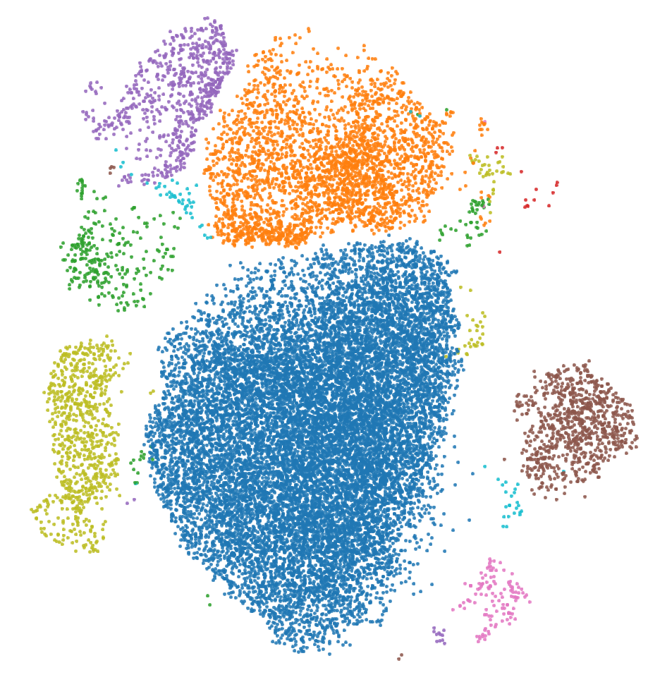
WILD TYPE
STOP1

Slide 3
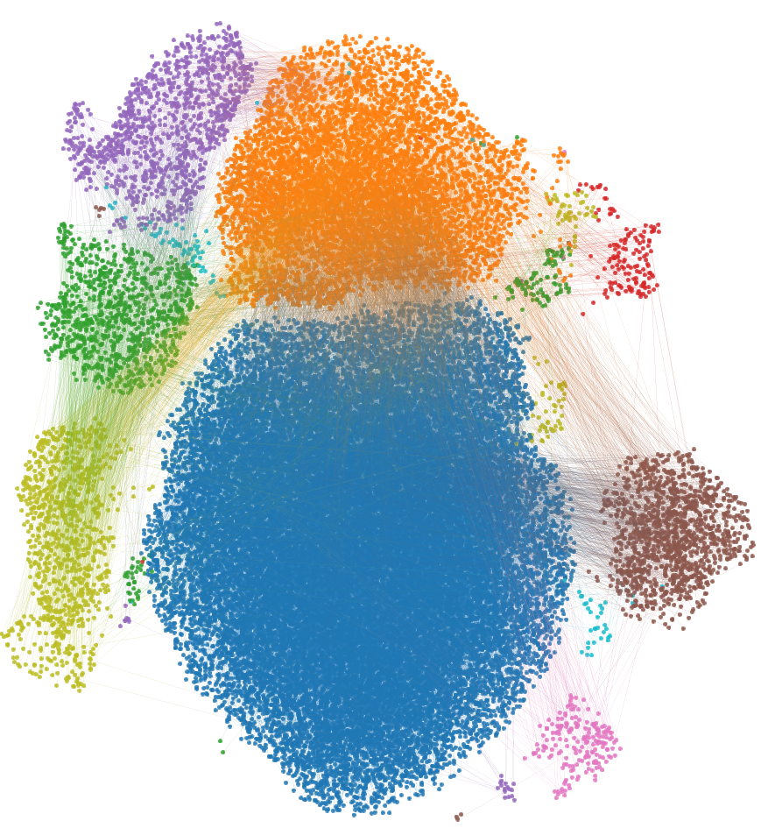
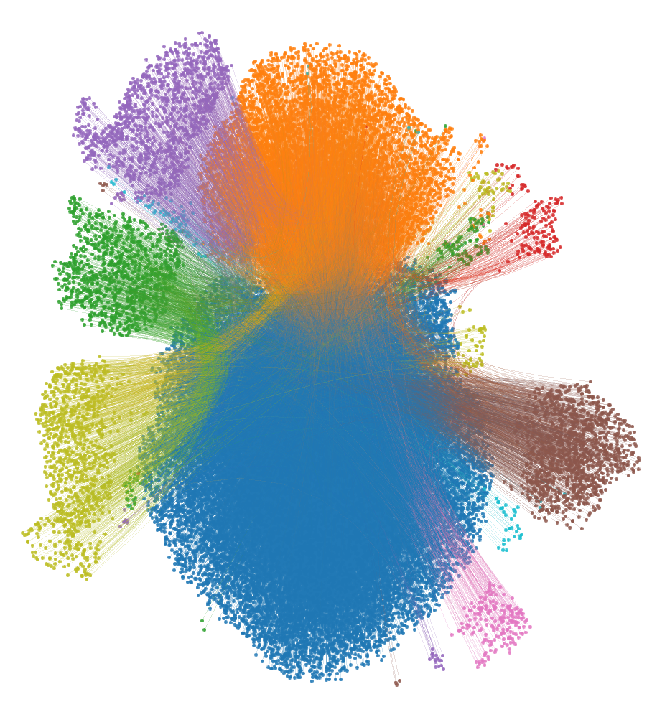

Slide 4
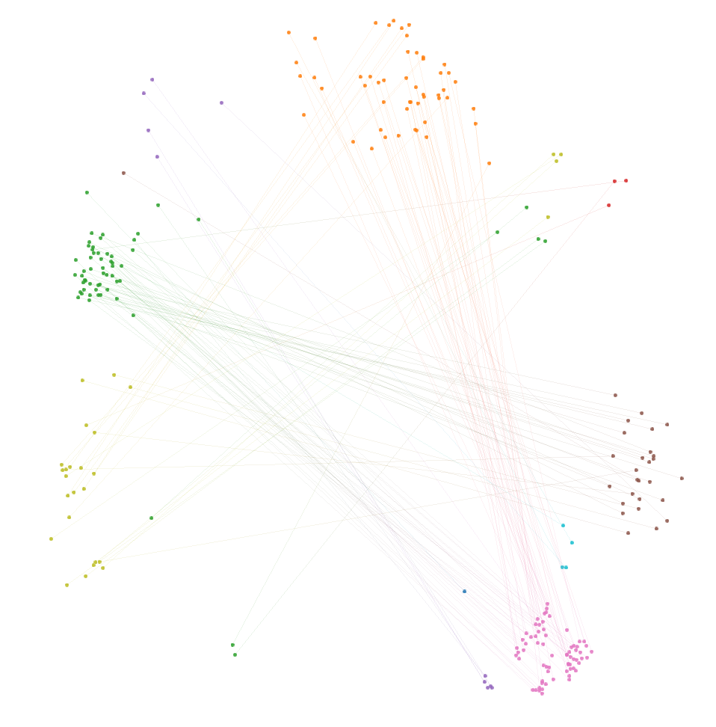
>75% UMAP distance
AT1G02220, AT1G03820, AT1G04800, AT1G04837, AT1G07550, AT1G07680, AT1G08165, AT1G08803, AT1G10640, AT1G11080, AT1G12630, AT1G13448, AT1G14480, AT1G14890, AT1G15040, AT1G20650, AT1G20990, AT1G23140, AT1G24530, AT1G30270, AT1G30320, AT1G30820, AT1G33055, AT1G34047, AT1G35730, AT1G51920, AT1G52560, AT1G64380, AT1G67710, AT1G67980, AT1G68240, AT1G68690, AT1G73120, AT1G76100, AT1G76210, AT1G78530, AT2G01010, AT2G01020, AT2G01021, AT2G01610, AT2G02380, AT2G04070, AT2G08820, AT2G11215, AT2G14247, AT2G14960, AT2G16586, AT2G22180, AT2G24710, AT2G28270, AT2G28570, AT2G34850, AT2G35710, AT2G36800, AT2G40610, AT2G40740, AT2G41082, AT3G01845, AT3G02040, AT3G02550, AT3G02870, AT3G06325, AT3G06345, AT3G09640, AT3G09922, AT3G10040, AT3G15630, AT3G15635, AT3G17790, AT3G21781, AT3G22420, AT3G22830, AT3G24130, AT3G26080, AT3G27400, AT3G30180, AT3G43190, AT3G46340, AT3G47720, AT3G48840, AT4G00770, AT4G01060, AT4G04040, AT4G04750, AT4G04960, AT4G05775, AT4G10265, AT4G10270, AT4G10550, AT4G11370, AT4G12090, AT4G12480, AT4G13190, AT4G19950, AT4G22690, AT4G23170, AT4G24110, AT4G24230, AT4G24260, AT4G25560, AT4G28150, AT4G31330, AT4G31370, AT4G34410, AT4G36570, AT4G39510, AT5G14180, AT5G17340, AT5G18670, AT5G20250, AT5G20790, AT5G26290, AT5G39160, AT5G40040, AT5G42040, AT5G43370, AT5G45870, AT5G49520, AT5G51760, AT5G55150, AT5G63180, AT5G63580, ATMG00020, ATMG00030, ATMG00060

